Slide 1
Project Proposal
Harry Hargreaves, Amanda Ruan, Cole Krushel, Caitlin Yau, Matthew Voynovich, Jackson Baimel

Slide 2
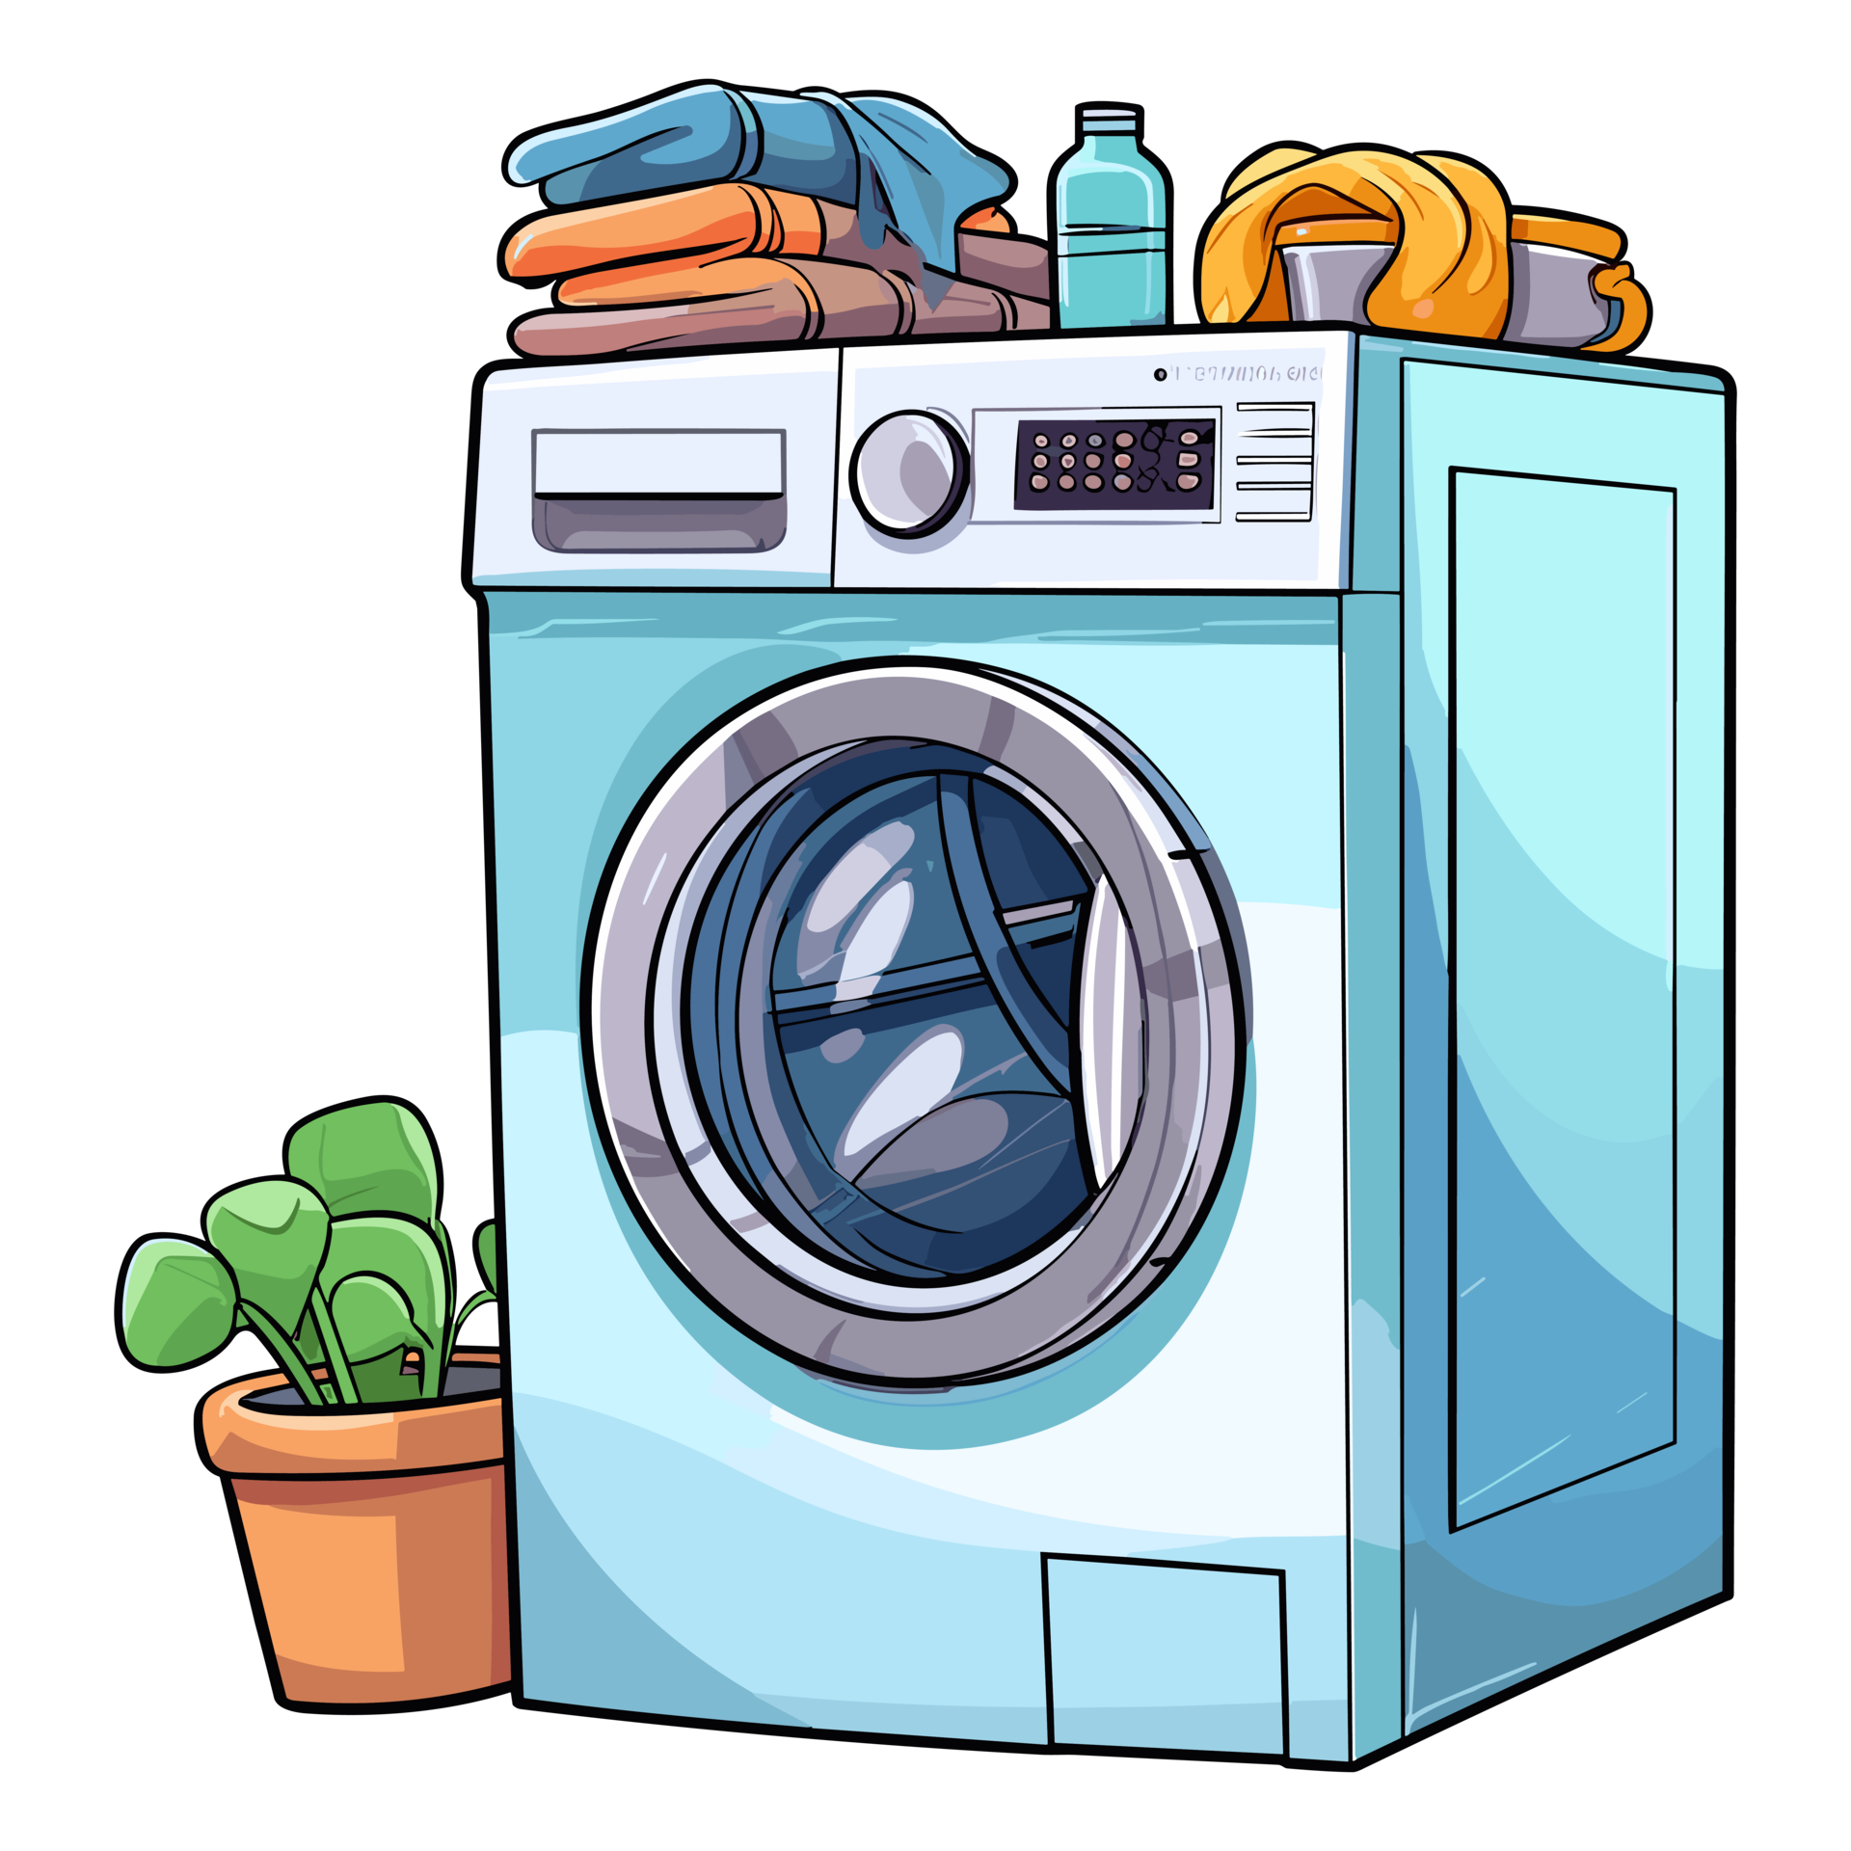
Visionary Vortex introduces… Fresh n’ Clean!!
Fresh n' Clean

Slide 3
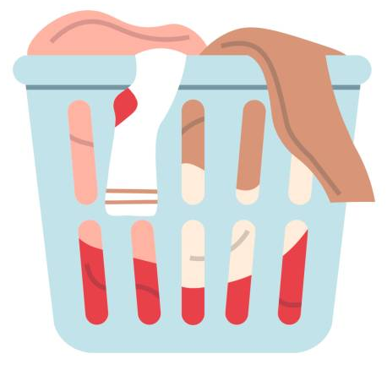



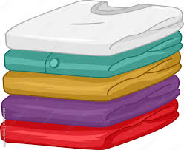
Imagine Uber for Laundry:
Fresh n' Clean

Slide 4
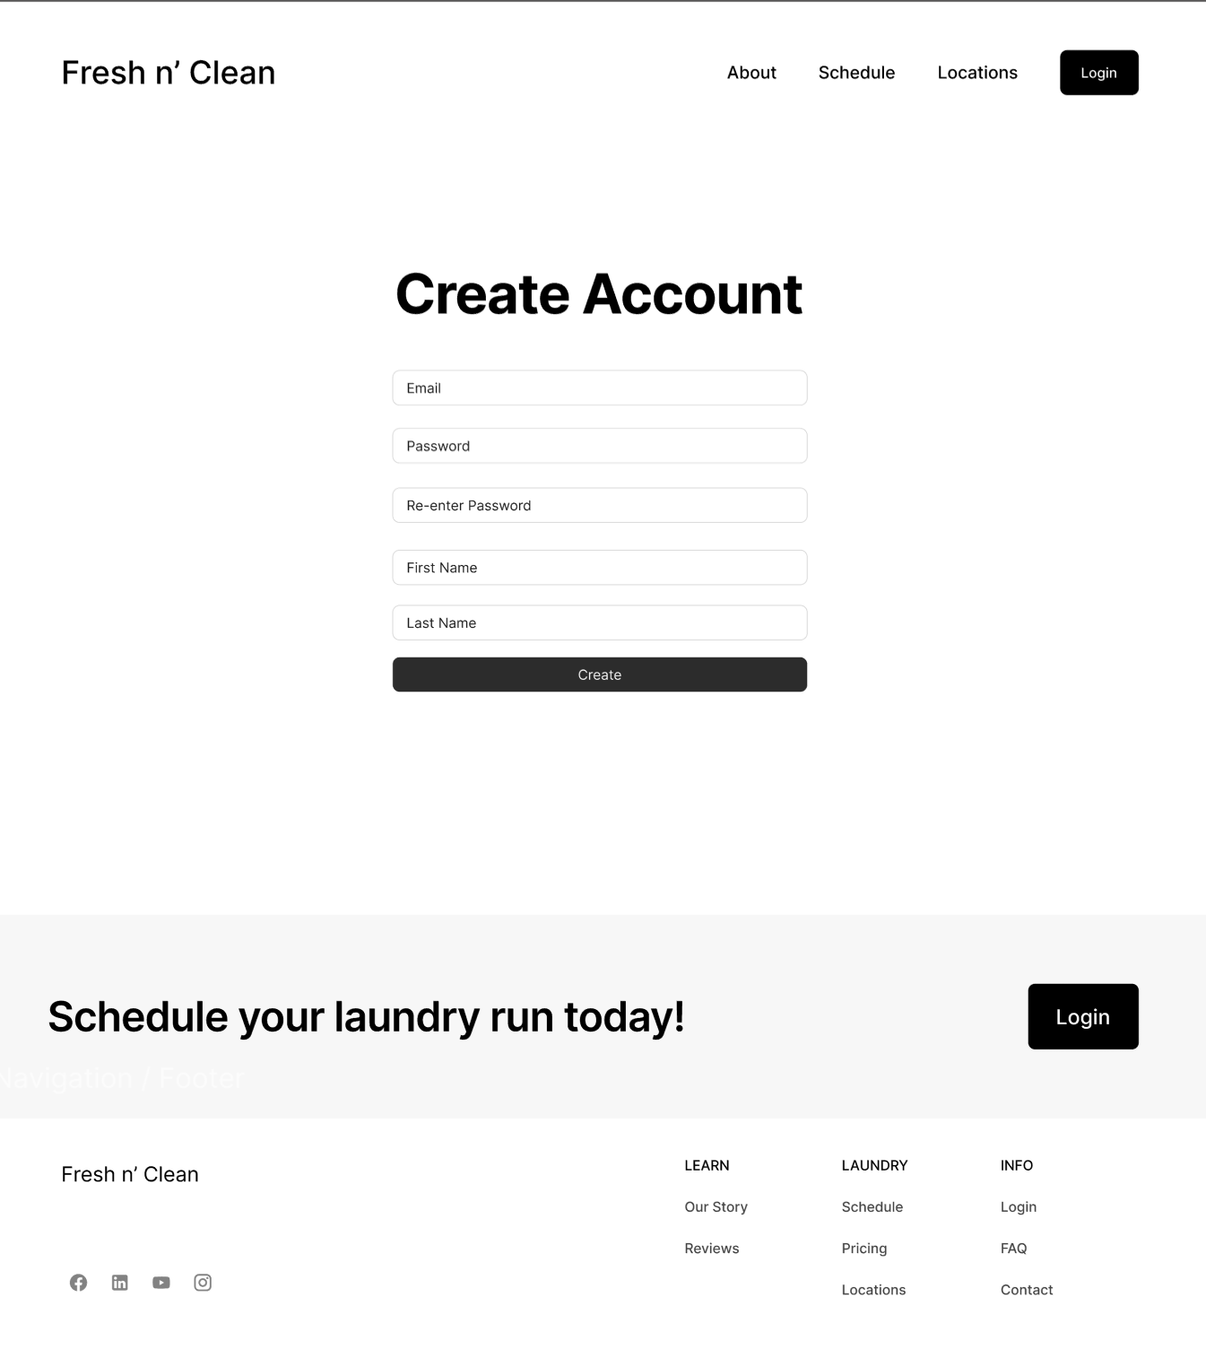
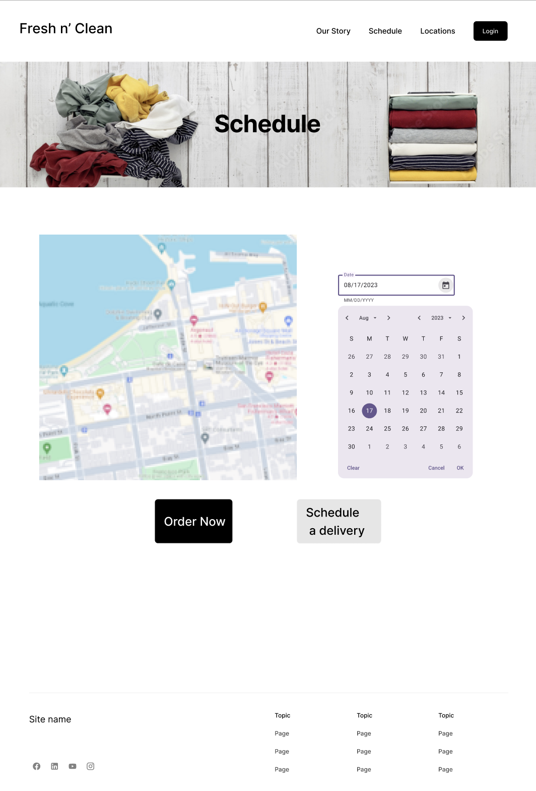
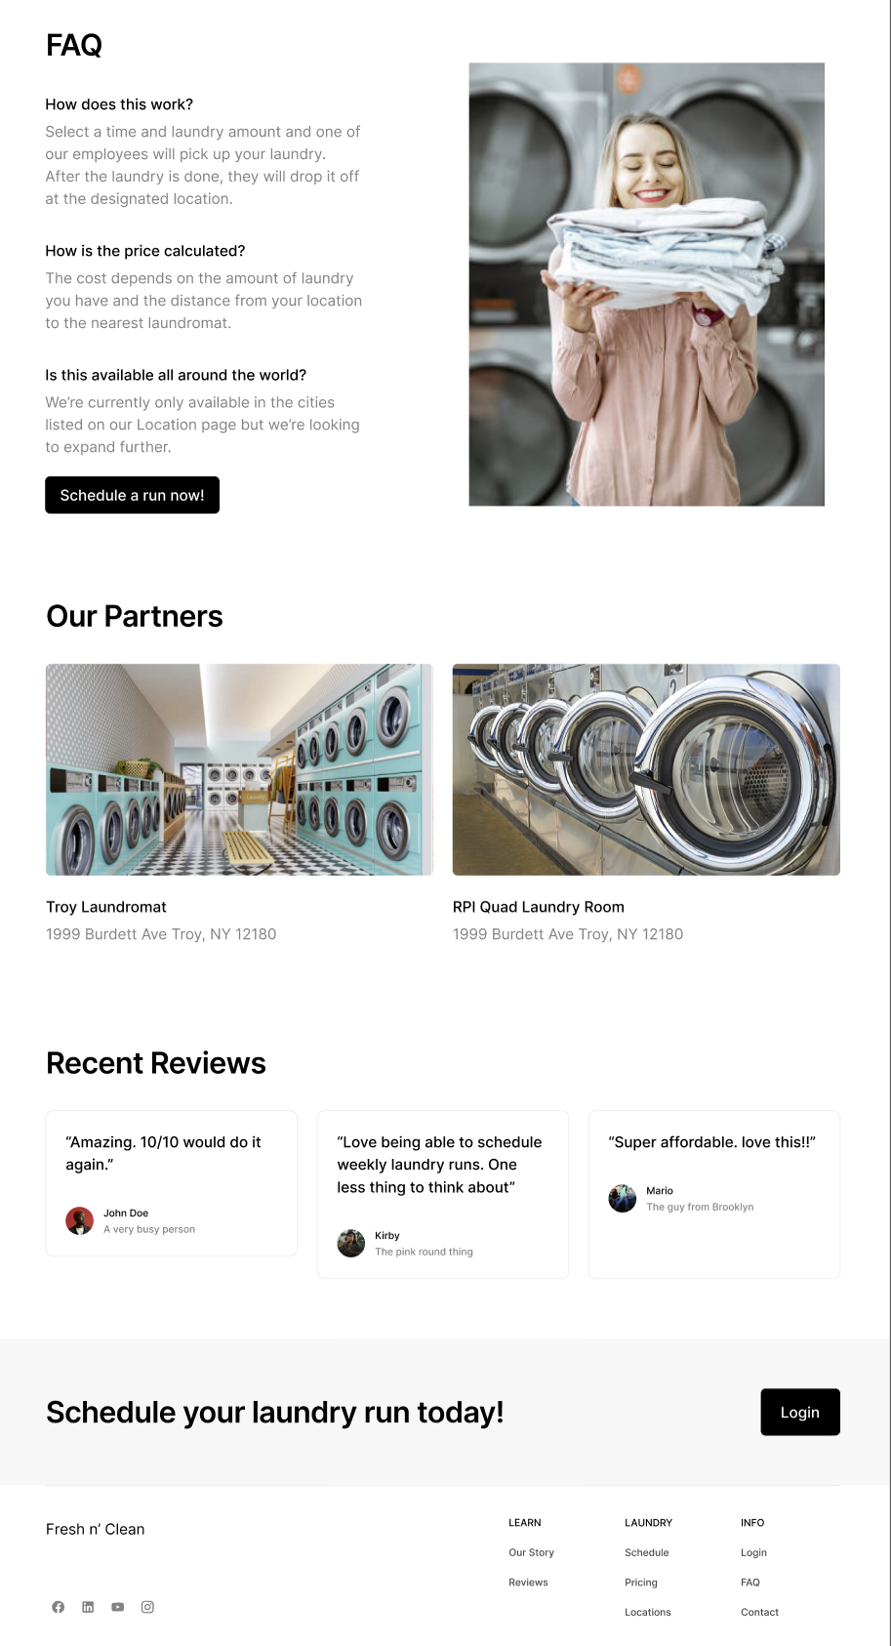
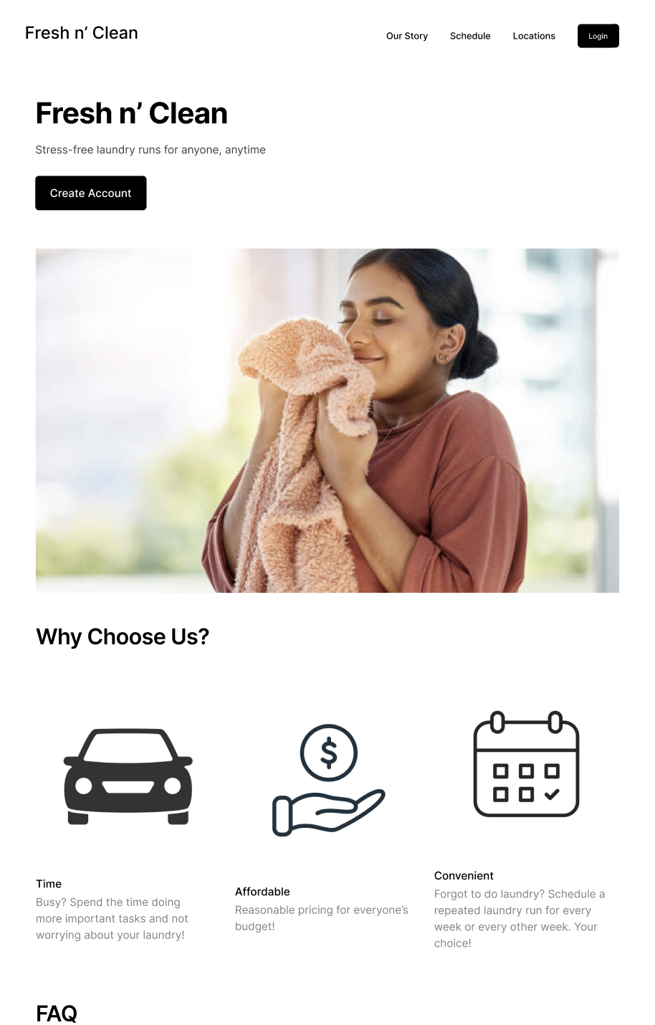
What will the app look like?
Fresh n' Clean

Slide 5
Who are our target users?
– People in Urban or Suburban areas with close proximity to laundromats.
– People without easy access to laundry equipment.
– People without time to wash clothes.
Fresh n' Clean

Slide 6
Who are our target users?
– People looking for a full or part-time job as a delivery service driver.
Fresh n' Clean

Slide 7
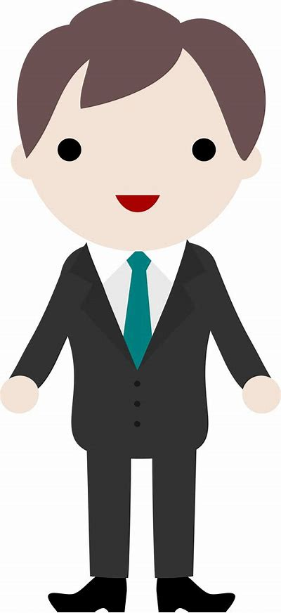

Who are our stakeholders?
– Laundromat Owners: increasing business to their business.
– Us, the developers: getting valuable experience creating web apps, and potentially as a revenue stream.
– Drivers: Acting as liaisons between the users and laundromats.
Fresh n' Clean

Slide 8


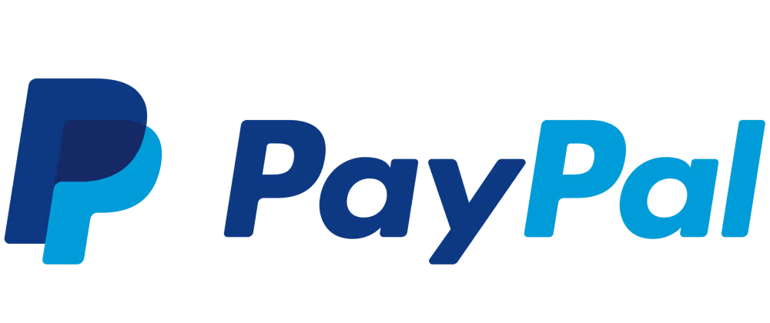




What technologies will we use?
Fresh n' Clean

Slide 9
What are our functional and non-functional requirements?
Functional:
– Website with functional javascript for database requests.
– Functional backend to store data.
– Functional implementation of a maps API such as Google Places.
Non-functional:
– A professional website.
– An external payment implementation.
Additionally:
– A way to view one’s history of orders.
– A 2-way rating system.
– Advertising functionality.
– Laundry type customization.
Fresh n' Clean

Slide 10
What is our timeline?
– Start work in mid-September.
– Achieve basic functionality by end of October.
– Achieve basic non-functional features by end of November.
– We will have bi-weekly Scrum sessions to encourage accountability and productivity between developers.
Fresh n' Clean

Slide 11
Thank you! Any Questions?

